Slide 1
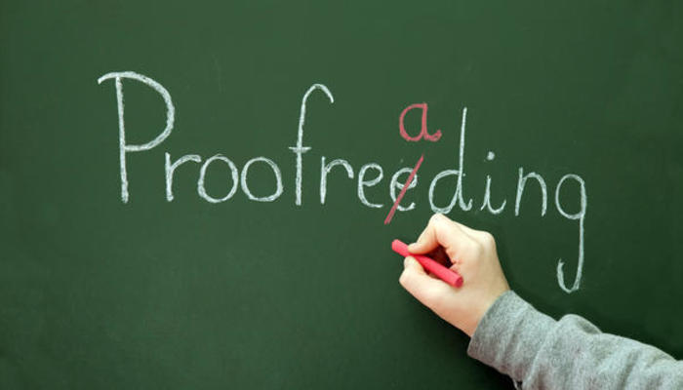
Proofreading

Slide 2

Proofreading finds mostly typing errors.
These errors may affect meaning.

Slide 3
Call me Pat.
Call me, Pat.
I’m sorry I love you.
I’m sorry. I love you.

Slide 4
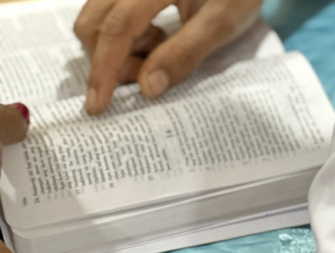
Correct typing and format are evidence of a quality translation.

Slide 5
From Galatians 5:
22But the fruit OF the spirit is love joy) peace, patience, Kindness, goodness, Faith, gentleness, and selfcontrol against such things there is no law . 24 those who belong to christ Jesus have cRucified the flesh with its passionsa nd desires²⁵ If we live by the Spirit, let us also walk” by thespirit?
²² But the fruit of the Spirit is love, joy, peace, patience, kindness, goodness, faith, ²³ gentleness, and self-control; against such things there is no law. ²⁴ Those who belong to Christ Jesus have crucified the flesh with its passions and desires. ²⁵ If we live by the Spirit, let us also walk by the Spirit.

Slide 6
From Galatians 5: Proper Number of Verses
22But the fruit OF the spirit is love joy) peace, patience, Kindness, goodness, Faith, gentleness, and selfcontrol against such things there is no law . 24 those who belong to christ Jesus have cRucified the flesh with its passionsa nd desires²⁵ If we live by the Spirit, let us also walk” by thespirit?
²² But the fruit of the Spirit is love, joy, peace, patience, kindness, goodness, faith, ²³ gentleness, and self-control; against such things there is no law. ²⁴ Those who belong to Christ Jesus have crucified the flesh with its passions and desires. ²⁵ If we live by the Spirit, let us also walk by the Spirit.

Slide 7
From Galatians 5: Beginnings of Sentences
22But the fruit OF the spirit is love joy) peace, patience, Kindness, goodness, Faith, gentleness, and selfcontrol against such things there is no law . 24 those who belong to christ Jesus have cRucified the flesh with its passionsa nd desires²⁵ If we live by the Spirit, let us also walk” by thespirit?
²² But the fruit of the Spirit is love, joy, peace, patience, kindness, goodness, faith, ²³ gentleness, and self-control; against such things there is no law. ²⁴ Those who belong to Christ Jesus have crucified the flesh with its passions and desires. ²⁵ If we live by the Spirit, let us also walk by the Spirit.

Slide 8
From Galatians 5: Endings of Sentences
22But the fruit OF the spirit is love joy) peace, patience, Kindness, goodness, Faith, gentleness, and selfcontrol against such things there is no law . 24 those who belong to christ Jesus have cRucified the flesh with its passionsa nd desires²⁵ If we live by the Spirit, let us also walk” by thespirit?
²² But the fruit of the Spirit is love, joy, peace, patience, kindness, goodness, faith, ²³ gentleness, and self-control; against such things there is no law. ²⁴ Those who belong to Christ Jesus have crucified the flesh with its passions and desires. ²⁵ If we live by the Spirit, let us also walk by the Spirit.

Slide 9
From John 6: Quotation Marks
⁶⁷ Then Jesus said to the twelve, “You do not want to go away also, do you?” ⁶⁸ Simon Peter answered him, “Lord, to whom would we go? You have words of eternal life, ⁶⁹ and we have believed and come to know that you are the Holy One of God.”
⁶⁷ Así que Jesús preguntó a los doce:
—¿También ustedes quieren marcharse?
⁶⁸ —Señor —contestó Simón Pedro—, ¿a quién iremos? Tú tienes palabras de vida eterna. ⁶⁹ Y nosotros hemos creído, y sabemos que tú eres el Santo de Dios.

Slide 10
From Galatians 5: Quotation Marks
22But the fruit OF the spirit is love joy) peace, patience, Kindness, goodness, Faith, gentleness, and selfcontrol against such things there is no law . 24 those who belong to christ Jesus have cRucified the flesh with its passionsa nd desires²⁵ If we live by the Spirit, let us also walk” by thespirit?
²² But the fruit of the Spirit is love, joy, peace, patience, kindness, goodness, faith, ²³ gentleness, and self-control; against such things there is no law. ²⁴ Those who belong to Christ Jesus have crucified the flesh with its passions and desires. ²⁵ If we live by the Spirit, let us also walk by the Spirit.

Slide 11
From John 6: Parentheses
¹ After these things, Jesus went away to the other side of the Sea of Galilee, also called the Sea of Tiberias. ² A great crowd was following him because they saw the signs that he was doing on those who were sick. ³ Jesus went up the mountain and there he sat down with his disciples. ⁴ (Now the Passover, the Jewish festival, was near.) ⁵ When Jesus looked up and saw a great crowd coming to him, he said to Philip, "Where are we going to buy bread so that these may eat?" ⁶ (But Jesus said this to test Philip, for he himself knew what he was going to do.)

Slide 12
From Galatians 5: Parentheses
22But the fruit OF the spirit is love joy) peace, patience, Kindness, goodness, Faith, gentleness, and selfcontrol against such things there is no law . 24 those who belong to christ Jesus have cRucified the flesh with its passionsa nd desires²⁵ If we live by the Spirit, let us also walk” by thespirit?
²² But the fruit of the Spirit is love, joy, peace, patience, kindness, goodness, faith, ²³ gentleness, and self-control; against such things there is no law. ²⁴ Those who belong to Christ Jesus have crucified the flesh with its passions and desires. ²⁵ If we live by the Spirit, let us also walk by the Spirit.

Slide 13
From Galatians 5: Capitalization (Names and Places in English)
22But the fruit OF the spirit is love joy) peace, patience, Kindness, goodness, Faith, gentleness, and selfcontrol against such things there is no law . 24 those who belong to christ Jesus have cRucified the flesh with its passionsa nd desires²⁵ If we live by the Spirit, let us also walk” by thespirit?
²² But the fruit of the Spirit is love, joy, peace, patience, kindness, goodness, faith, ²³ gentleness, and self-control; against such things there is no law. ²⁴ Those who belong to Christ Jesus have crucified the flesh with its passions and desires. ²⁵ If we live by the Spirit, let us also walk by the Spirit.

Slide 14
From Galatians 5: Miscellaneous
22But the fruit OF the spirit is love joy) peace, patience, Kindness, goodness, Faith, gentleness, and selfcontrol against such things there is no law . 24 those who belong to christ Jesus have cRucified the flesh with its passionsa nd desires²⁵ If we live by the Spirit, let us also walk” by thespirit?
²² But the fruit of the Spirit is love, joy, peace, patience, kindness, goodness, faith, ²³ gentleness, and self-control; against such things there is no law. ²⁴ Those who belong to Christ Jesus have crucified the flesh with its passions and desires. ²⁵ If we live by the Spirit, let us also walk by the Spirit.

Slide 15
Chapter Headings
Chapter One
¹ That which was from the beginning, which we have heard, which we have seen with our eyes, which we have looked at and our hands have touched, concerning the Word of life— ² the life was made known, and we have seen and testify and proclaim to you the eternal life, which was with the Father, and which has been made known to us. ³ That which we have seen and heard we declare also to you, so you also will have fellowship with us. Our fellowship is with the Father and with his Son, Jesus Christ. ⁴ Also, we are writing these things to you so that our joy will be complete. ¹
⁵ This is the message that we have heard from him and are proclaiming to you: God is light, and in him there is no darkness at all. ⁶ If we say that we have fellowship with him and walk in darkness, we are lying and are not practicing the truth. ⁷ But if we walk in the light as he is in the light, we have fellowship with one another, and the blood of Jesus his Son cleanses us from every sin. ⁸ If we say that we have no sin, we are deceiving ourselves, and the truth is not in us. ⁹ But if we confess our sins, he is faithful and just to forgive us our sins and cleanse us from all unrighteousness. ¹⁰ If we say that we have not sinned, we make him out to be a liar, and his word is not in us.
2
¹ Children, I am writing these things to you so that you will not sin. But if anyone sins, we have an advocate with the Father, Jesus Christ, the one who is righteous. ² He is the atoning sacrifice for our sins, and not for ours only, but also for the whole world. ³ We know that we have come to know him, if we keep his commandments. ⁴ The one who says "I know God" but does not keep his commandments is a liar, and the truth is not in him. ⁵ But whoever keeps his word, in him truly the love of God has been perfected. By this we know that we are in him: ⁶ whoever says that he remains in God should himself also walk just as he walked.
Chpater 2
¹ See what kind of love the Father has given to us, that we should be called children of God, and this is what we are. For this reason, the world does not know us, because it did not know him. ¹ ² Beloved, we are now children of God, and it has not yet been revealed what we will be. We know that when Christ appears, we will be like him, for we will see him just as he is. ³ Everyone who has this hope in him purifies himself just as he is pure. ⁴ Everyone who sins is committing acts of lawlessness, for sin is lawlessness. ⁵ You know that Christ was revealed in order to take away sins, and in him there is no sin. ⁶No one who remains in him will keep on sinning. No one who continues to sin has seen him or known him. ⁷ Children, do not let anyone lead you astray. The one who does righteousness is righteous, just as Christ is righteous. ⁸ The one who commits sin is from the devil, for the devil has sinned from the beginning. For this reason the Son of God was revealed, so that he would destroy the devil's works.

Slide 16
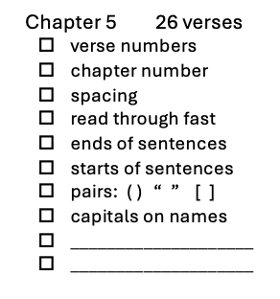
22But the fruit OF the spirit is love joy) peace, patience, Kindness, goodness, Faith, gentleness, and selfcontrol against such things there is no law . 24 those who belong to christ Jesus have cRucified the flesh with its passionsa nd desires²⁵ If we live by the Spirit, let us also walk” by thespirit?
One chapter at a time
One category at a time
Mark the corrections
Mark the Checklist box when each category is completed

Slide 17
Try it

Slide 18


